Slide 1
Using Parameters in omnet++
Cairo University Computer Networks-1 Faculty of Engineering CMP405-A /CMPN405 Computer Department Fall 2023
lab2

Slide 2
Today’s Outline
Using Parameters in omnet++
Random number generators
Lab2 Requirement
How to import projects in omnet++

Slide 3
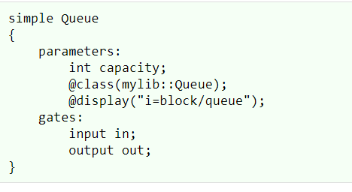
Parameters in NED language
Parameters are variables that belong to a module.
Simple and compound modules can have parameters as well.
This is a .NED file
Notes:
Manual link: https://doc.omnetpp.org/omnetpp/manual/

Slide 4
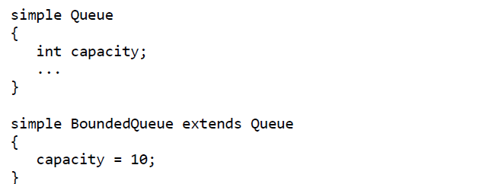
Parameters in NED language
Simple modules can be extended (or specialized) via subclassing using parameters
Notes:
Manual link: https://doc.omnetpp.org/omnetpp/manual/

Slide 5
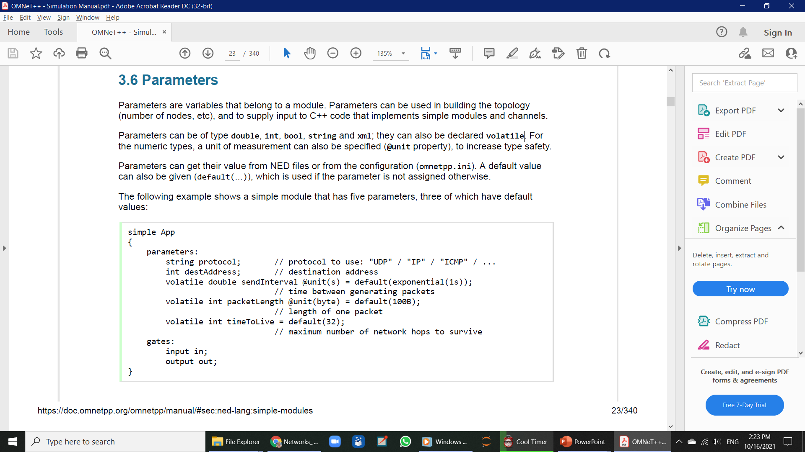
Parameters in NED language
Parameters can be of type double, int ,bool , string and other custom types(units).
Notes:
Manual link: https://doc.omnetpp.org/omnetpp/manual/

Slide 6
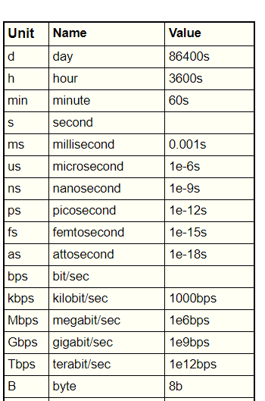
Parameters in NED language
@unit() declaration specify the measurement unit for the parameter.
@unit(s) accepts milliseconds, nanoseconds, minutes, hours, etc.,
@unit(byte) accepts kilobytes, megabytes, etc. as well.
Notes:
Manual link: https://doc.omnetpp.org/omnetpp/manual/

Slide 7
Parameters in NED language
Parameters can be of type double, int ,bool , string and other custom types(units).
They can also be declared volatile
What is the use of volatile?
Notes:
Manual link: https://doc.omnetpp.org/omnetpp/manual/

Slide 8
Parameters in NED language
Parameters can be assigned values in different ways:
1) using const /(default) values
2) using default function output
Notes:
Manual link: https://doc.omnetpp.org/omnetpp/manual/

Slide 9
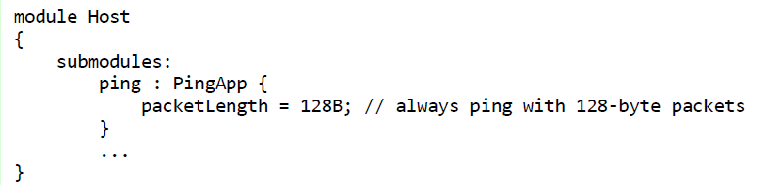
Parameters in NED language
Parameters can be assigned values in different ways
3) in the submodule instantiation inside compound modules
Notes:
Manual link: https://doc.omnetpp.org/omnetpp/manual/

Slide 10
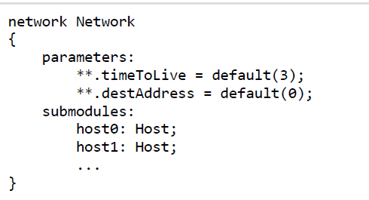
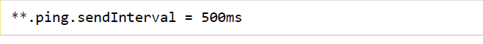
Parameters in NED language
Parameters can be assigned values in different ways
4) using wildcards in any .NED file (especially in the .ini configuration file)
This is inside the network .NED file
This is inside the .ini file
Notes:
Manual link: https://doc.omnetpp.org/omnetpp/manual/

Slide 11
Parameters in NED language
* : matches zero or more characters except dot (.)
** : matches zero or more characters (any character)
{a-f} : set: matches a character in the range a-f
{^a-f}: negated set: matches a character NOT in the range a-f
[38..150] : index range: any number in square brackets in the range 38..150, inclusive; both limits are optional
Notes:
Manual link: https://doc.omnetpp.org/omnetpp/manual/

Slide 12
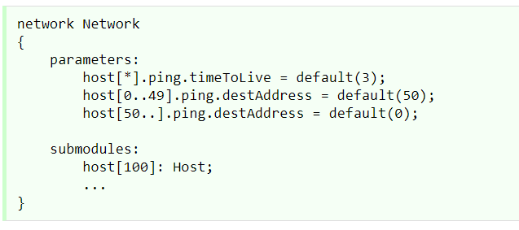
Parameters in NED language
Parameters can be assigned values in different ways
4) using wildcards in any .NED file (especially in the .ini configuration file)
This is inside the network .NED file
Notes:
Manual link: https://doc.omnetpp.org/omnetpp/manual/

Slide 13
Parameters linkage to the .cc files
What if we want to read parameter values inside the .cc behavior files ?
Notes:
Manual link: https://doc.omnetpp.org/omnetpp/manual/

Slide 14
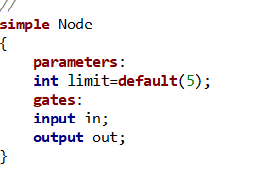
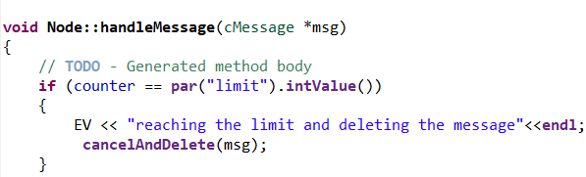
Parameters linkage to the .cc files
Using the function par
par(“parameter name”).conversion value()
Example:
Inside the Node.ned file Inside the Node.cc file
Notes:
Manual link: https://doc.omnetpp.org/omnetpp/manual/

Slide 15
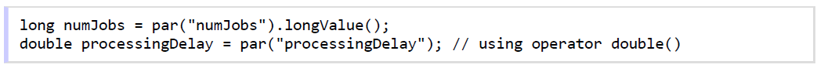
Parameters linkage to the .cc files
Other conversion type functions:
boolValue(), longValue(), doubleValue(), stringValue(), stdstringValue().
There are also overloaded type cast operators for the corresponding types(bool; int, long, double)
Notes:
Manual link: https://doc.omnetpp.org/omnetpp/manual/

Slide 16
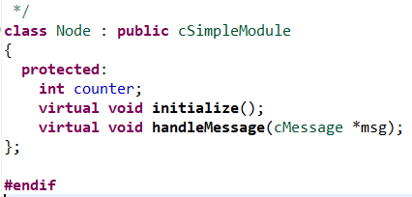
Parameters linkage to the .cc files
Careful not to confuse the .NED parameters with the .cc class data members.
Inside the Node.h file Inside the Node.cc file
Notes:
Manual link: https://doc.omnetpp.org/omnetpp/manual/

Slide 17
Random number generators
Omnet++ offers utility functions to sample from many different distributions.
For example: the uniform function returns a random number between a and b.
uniform(int a, int b)
To generate a random start every time, set the seed to any number in the .ini file like this:
seed-set=522
Notes:
Manual link: https://doc.omnetpp.org/omnetpp/manual/

Slide 18
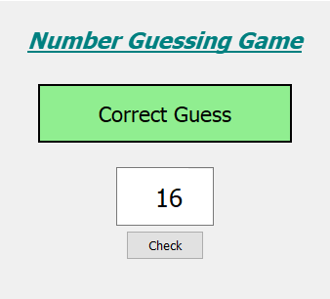
Omnet++ Lab2 requirement
Implement a random guessing game
One of the nodes acts as player1 and the other as player2.
This is not how your omnet GUI should look like , it is just for illustration.
Notes:
Manual link: https://doc.omnetpp.org/omnetpp/manual/

Slide 19
Omnet++ Lab2 requirement
Player1 generates a random number at the beginning of the game and prints it to the console. “note that the number should be constant through the game afterwards.
The number ranges from 0 to 10 .
Player1 signals player 2 to send messages containing his guesses one at a time.
Notes:
Manual link: https://doc.omnetpp.org/omnetpp/manual/

Slide 20
Omnet++ Lab2 requirement
Player2 randomly chooses a guess and sends it to player1 .
The guess ranges from 0 to 10 .
If the guess is not correct, player1 sends to player2 a “wrong guess” message .
If the guess is correct, player1 sends a “correct guess” message to player2 and the simulation is finished.
Notes:
Manual link: https://doc.omnetpp.org/omnetpp/manual/

Slide 21
Omnet++ Lab2 requirement
Print all the messages to the console also.
Print the guessing number at the beginning .
Hint: you may need to implement two different simple modules, one for player1 and one for player2.
Hint: there is a msg->setName() function that changes the name property.
Don’t send the real number to player2 clearly :D
Free your dynamically memory allocations carefully.
Notes:
Manual link: https://doc.omnetpp.org/omnetpp/manual/

Slide 22
Omnet++ Lab1 delivery
How to import a project in omnet++ ?
1) inside omnet++ go to file -> open project from file system.
2) write in the import source the exact directory to your unzipped project file.
Notes:
Manual link: https://doc.omnetpp.org/omnetpp/manual/

Slide 23
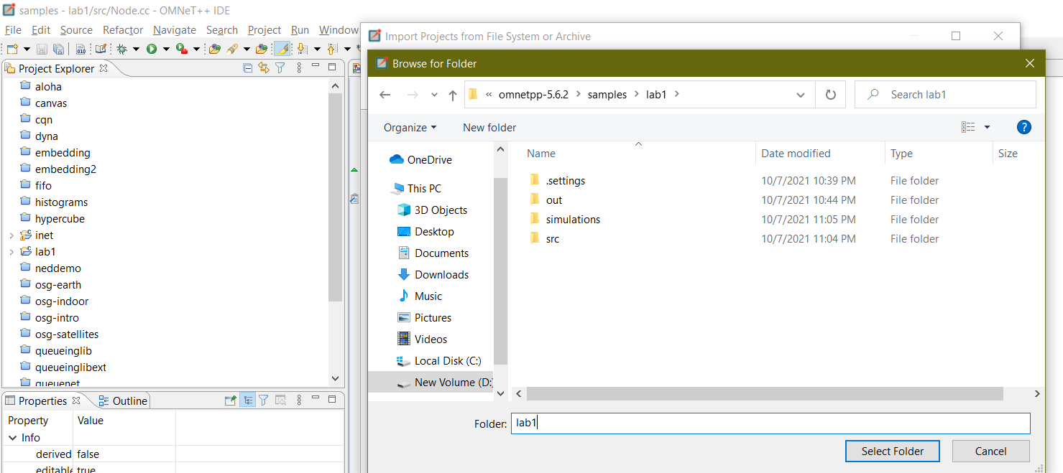
Omnet++ Lab1 delivery
3) make sure that the directory path you provide has the src folder inside it directory.
Notes:
Manual link: https://doc.omnetpp.org/omnetpp/manual/

Slide 24
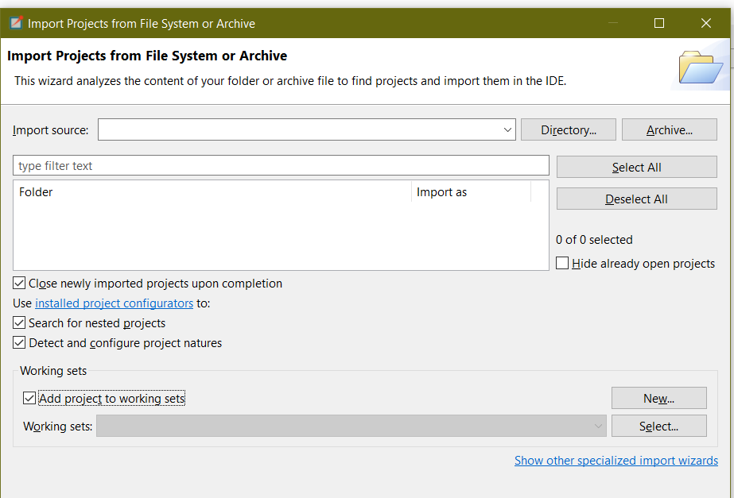
Omnet++ Lab1 delivery
How to import a project in omnet++ ?
4) check these checkboxes and finish.
Notes:
Manual link: https://doc.omnetpp.org/omnetpp/manual/

Slide 25
Omnet++ helper functions
atoi(cstr) to convert a c_str, that contains a number, to int.
int(uniform(0,10)) to generate random integers from 0 to 9.
seed-set=any number to make the generator random.
par(“parname").intValue() to convert the parameter to int.
Notes:
Manual link: https://doc.omnetpp.org/omnetpp/manual/

Slide 26
Thank You !!

